Slide 1
Komputasi Statistika C
Jackknife and bootsrap resampling

Slide 2
Bootstrapping is the most popular resampling method today. It uses sampling with replacement to estimate the sampling distribution for a desired estimator. The main purpose for this particular method is to evaluate the variance of an estimator. It does have many other applications, including:
Estimating confidence intervals and standard errors for the estimator (e.g. the standard error for the mean),
Estimating precision for an estimator θ,
Dealing with non-normally distributed data,
Calculating sample sizes for experiments.

Slide 3
Bootstrap Algorithm
Bootstrapping
Assuming the sample accurately reflects the population from which it is drawn
Generate a large number of “bootstrap” samples by resampling (with replacement) from the dataset
Resample with the same structure (dependence, sample sizes) as used in the original sample
Compute your estimator, , (here, ), for each of the bootstrap samples
Compute the “standard deviation” from the statistics calculated above.

Slide 4
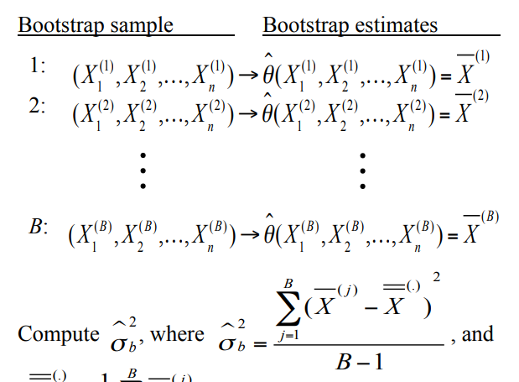
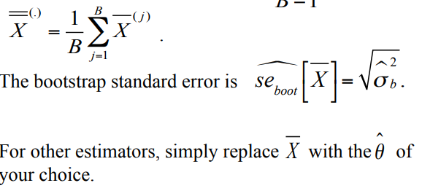
Bootstrap Algorithm

Slide 5
Jackknife
The Jackknife works by sequentially deleting one observation in the data set, then recomputing the desired statistic. It is computationally simpler than bootstrapping, and more orderly (i.e. the procedural steps are the same over and over again). This means that, unlike bootstrapping, it can theoretically be performed by hand. However, it's still fairly computationally intensive so although in the past it was common to use by-hand calculations, computers are normally used today. One area where it doesn't perform well for non-smooth statistics (like the median) and nonlinear (e.g. the correlation coefficient).
The main application for the Jackknife is to reduce bias and evaluate variance for an estimator. It can also be used to:
Find the standard error of a statistic,
Estimate precision for an estimator θ.

Slide 6


Jackknife Algorithm
For a dataset with n observations, compute n estimates by sequentally omitting each observation from the dataset and estimating on the remaining n – 1 observations.
Using the n jackknife estimates,
we estimate the standard error of the estimator as
Unlike the bootstrap, the jackknife standard error estimate will not change for a given sample

